Slide 1
Learning Objective
I will use the sine and cosine rule to solve for side lengths and angles.
Success Criteria
At the end of the lesson, I will be able to:
Determine the unknown sides and angles using sine and cosine rules
Determine the area of a non-right angled triangle.

Slide 2
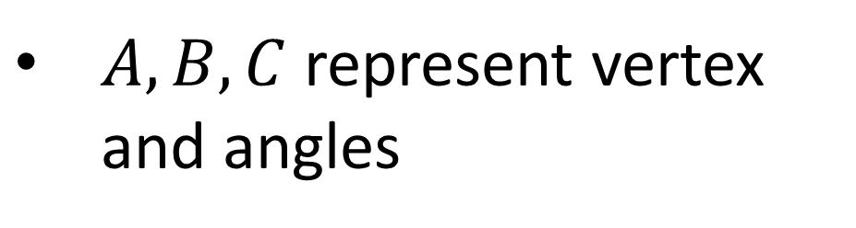
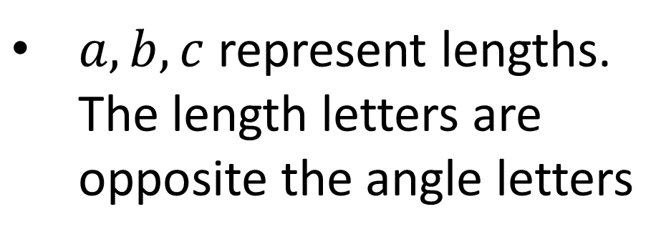
Activating Prior Knowledge
Triangles are labelled with 3 pairs of letters:
Labelling of Angles and Sides
B
$A, B, C$represent vertex and angles
$a, b, c$ represent lengths. The length letters are opposite the angle letters
c
a
A
C
b

Slide 3
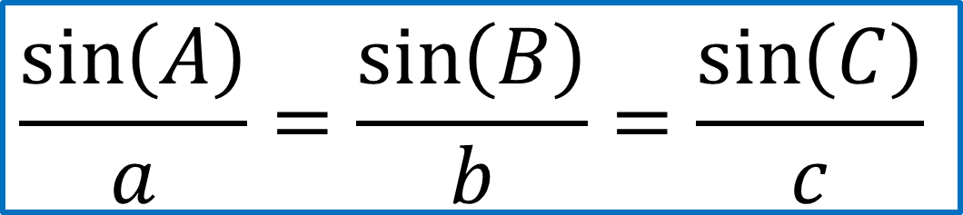
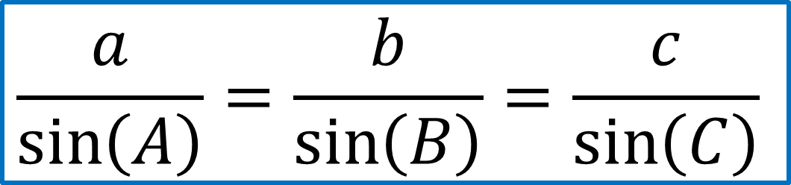
Concept Development
Sine Rule
$$\frac{a}{\sin\left(A\right)}=\frac{b}{\sin\left(B\right)}=\frac{c}{\sin\left(C\right)}$$
B
c
a
OR
A
$$\frac{\sin\left(A\right)}{a}=\frac{\sin\left(B\right)}{b}=\frac{\sin\left(C\right)}{c}$$
C
b

Slide 4
Concept Development
The Sine Rule:
C
b
a
A
B
c
You can only use the Sine Rule if you have a “matching pair”.
You have to know one angle, and the side opposite it.
Then if you have just one other side or angle, you can use the Sine Rule to find any of the other angles or sides.

Slide 5
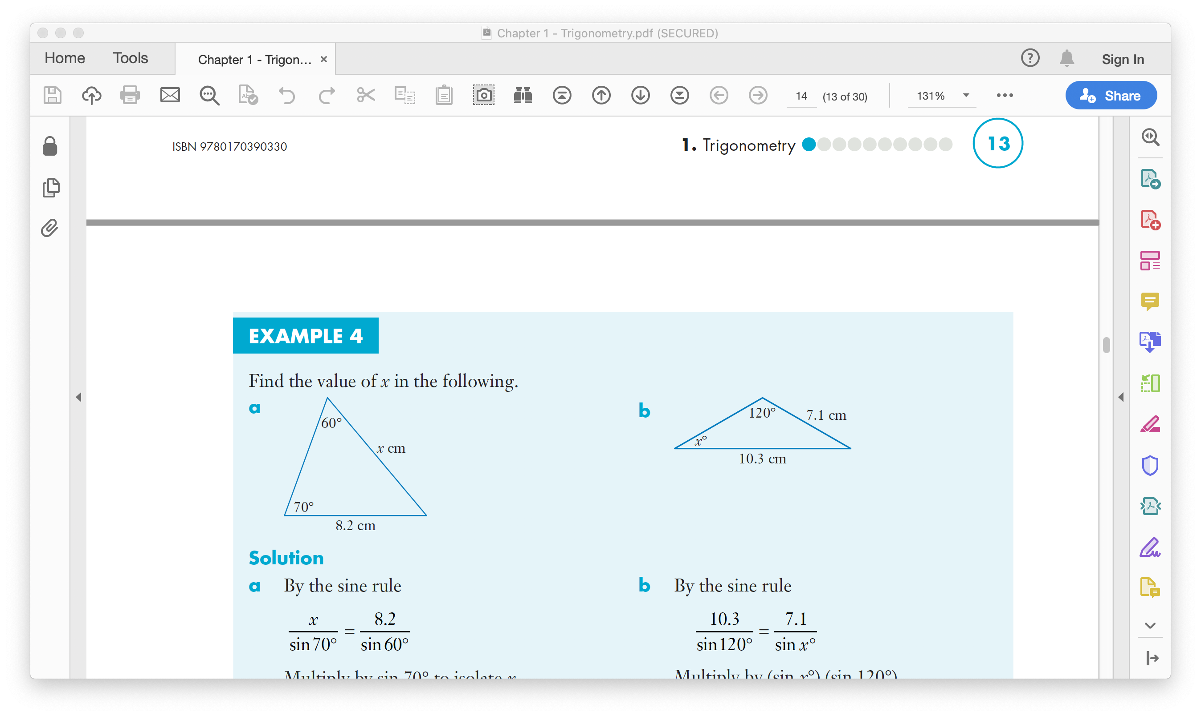
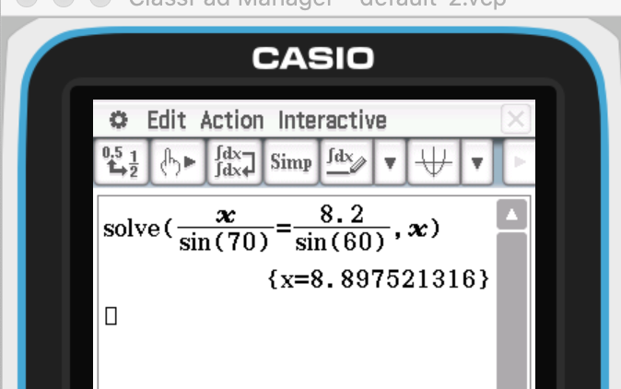
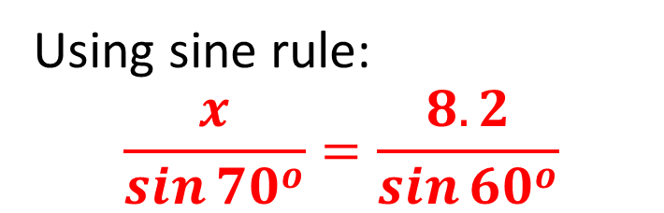

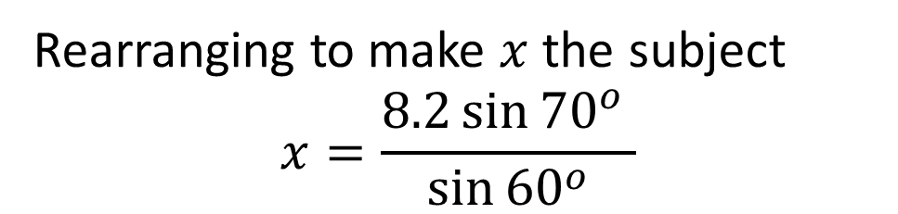
Skill Development
Use classpad ‘solve’ function
Using sine rule:
$$\frac{x}{\sin{{70}^{o}}}=\frac{8.2}{\sin{{60}^{o}}}$$
Rearranging to make $x$ the subject
$$x=\frac{8.2\sin{{70}^{o}} }{\sin{{60}^{o}}}$$
$$x=8.9 cm$$

Slide 6
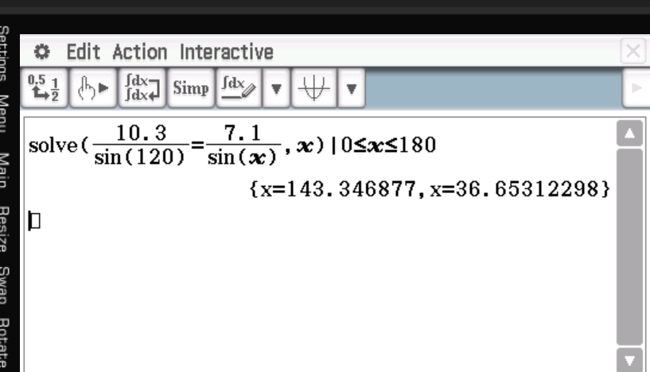
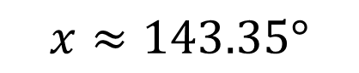
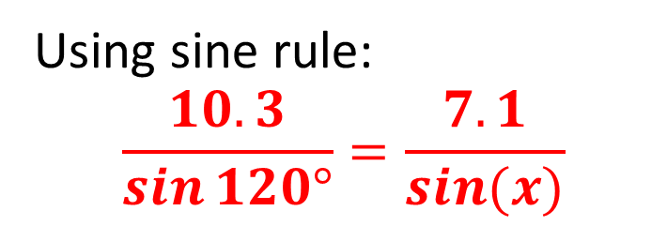
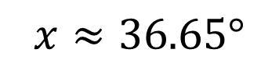
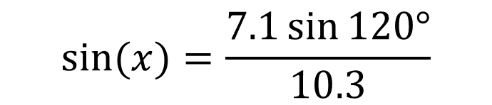

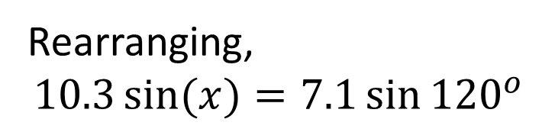
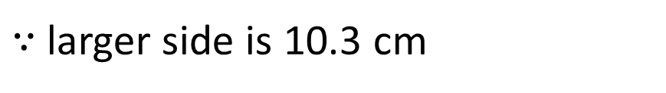
Guided Practice
Use classpad ‘solve’ function
Using sine rule:
$$\frac{10.3}{\sin{120°}}=\frac{7.1}{\sin{(x)}}$$
Rearranging,
$$10.3\sin{(x)}=7.1\sin{{120}^{o}}$$
$$\sin{(x)}=\frac{7.1\sin{120°}}{10.3}$$
$$x≈36.65°$$
$$x≈143.35°$$
$∵$larger side is 10.3 cm

Slide 7
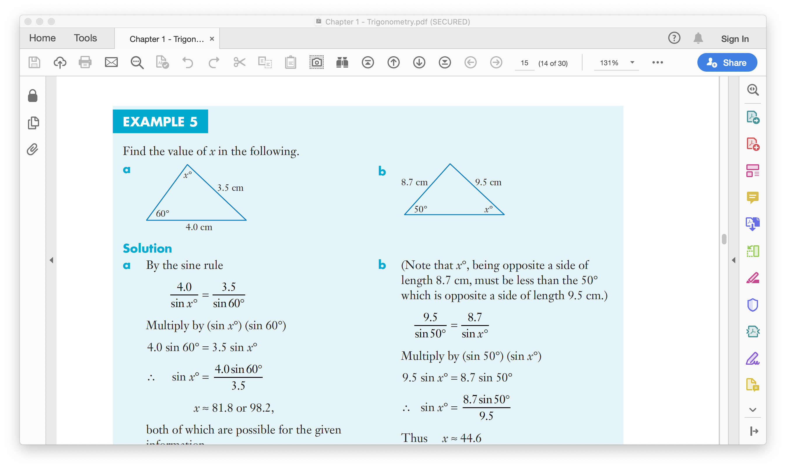
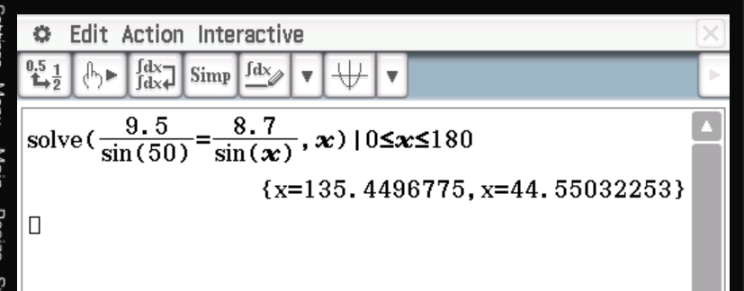
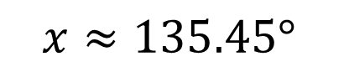
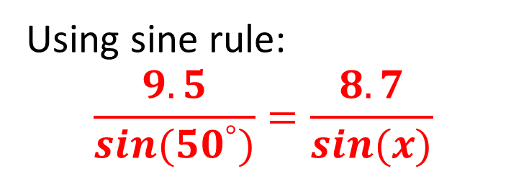
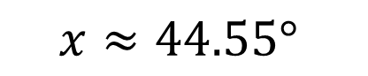
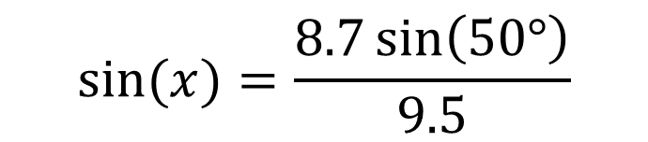
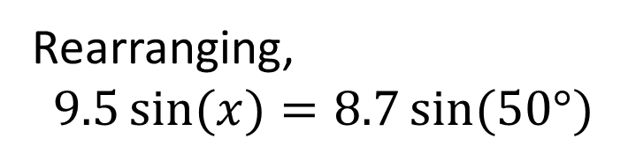
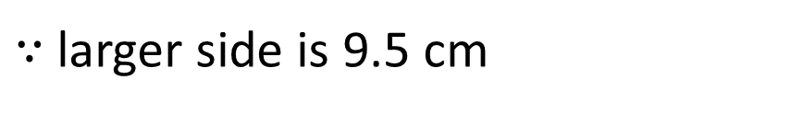
Guided Practice
Use classpad ‘solve’ function
Using sine rule:
$$\frac{9.5}{\sin{{(50}^{°})}}=\frac{8.7}{\sin{(x)}}$$
Rearranging,
$$9.5\sin{(x)}=8.7\sin{(50°)}$$
$$\sin{(x)}=\frac{8.7\sin\left(50°\right)}{9.5}$$
$$x≈44.55°$$
$$x≈135.45°$$
$∵$larger side is 9.5 cm

Slide 8

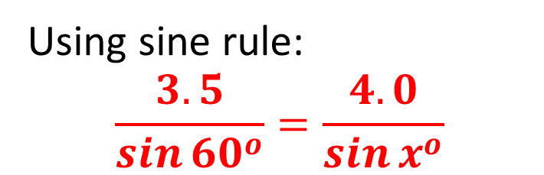
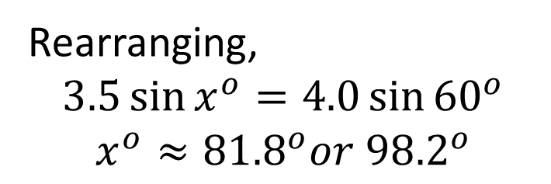
Guided Practice
Use classpad ‘solve’ function
Using sine rule:
$$\frac{3.5}{\sin{{60}^{o}}}=\frac{4.0}{\sin{x^{o}}}$$
Rearranging,
$$3.5\sin{x^{o}}=4.0\sin{{60}^{o}}$$
$$x^{o}≈{81.8}^{o}or{ 98.2}^{o}$$
Both angles are possible, and we need to state them.

Slide 9
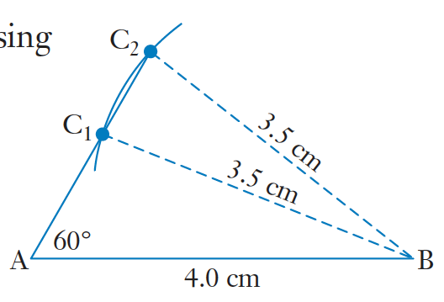
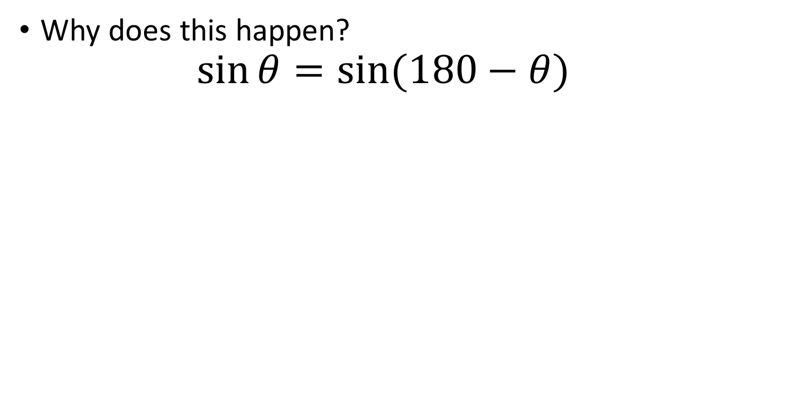
Ambiguous Case
Concept Development
Why does this happen?
$$\sin{θ=sin⁡(180−θ)}$$

Slide 10
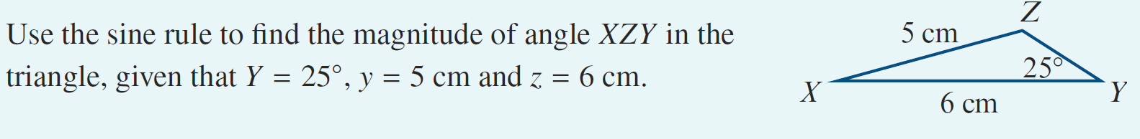
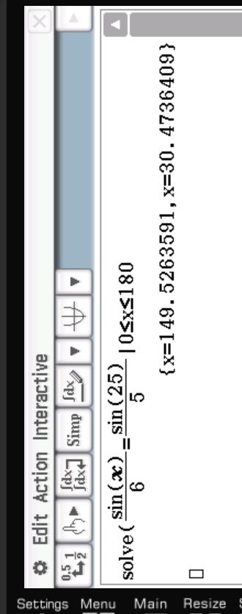
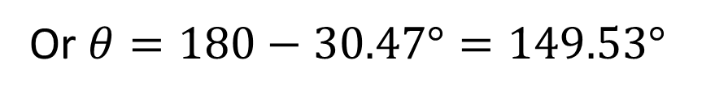
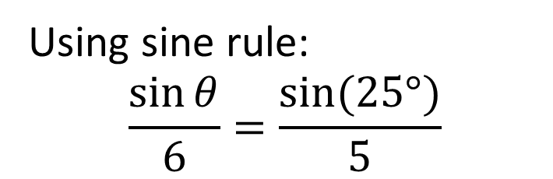

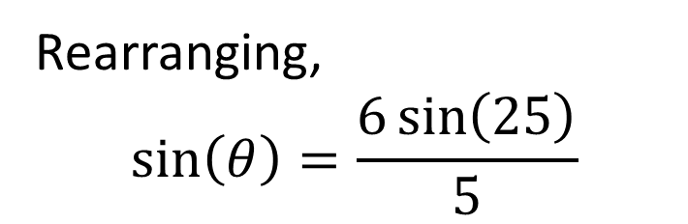
Guided Practice
Using sine rule:
$$\frac{\sin{θ}}{6}=\frac{\sin{(25°)}}{5}$$
Rearranging,
$$\sin\left(θ\right)=\frac{6\sin\left(25\right)}{5}$$
$$θ=30.47°$$
Or $θ=180−30.47°=149.53°$

Slide 11
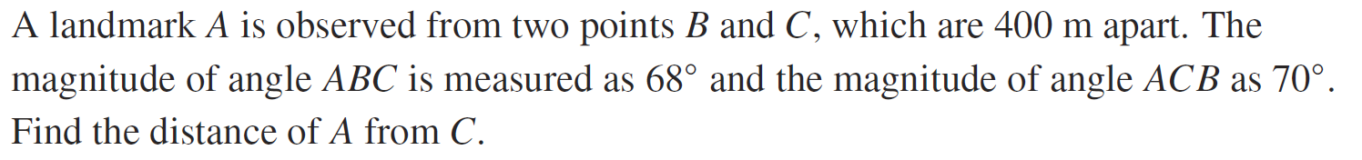
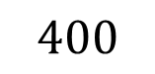
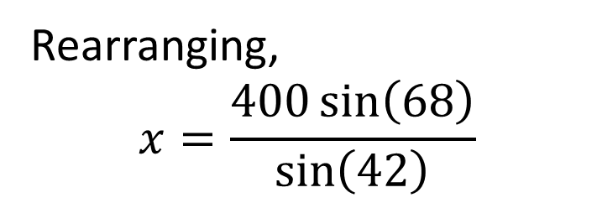
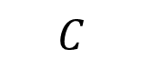
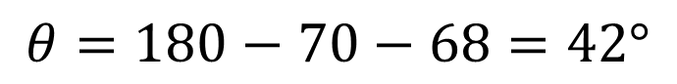
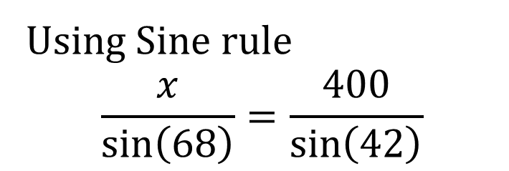
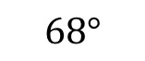
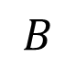
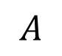
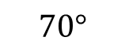

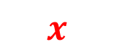
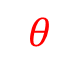
Guided Practice
$$θ=180−70−68=42°$$
$$B$$
Using Sine rule
$$\frac{x}{\sin\left(68\right)}=\frac{400}{\sin\left(42\right)}$$
$$68°$$
$$400$$
$$θ$$
$$A$$
$$70°$$
$$x$$
$$C$$
Rearranging,
$$x=\frac{400\sin\left(68\right)}{\sin\left(42\right)}$$
$$x=554.26 m$$

Slide 12

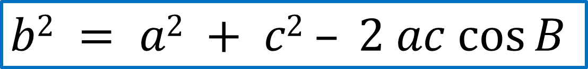




Concept Development
Cosine Rule
$$c2 = a2 + b2 – 2 ab cos⁡C$$
B
OR
c
a
$$b2 = a2 + c2 – 2 ac cos⁡B$$
OR
A
$$a2 = b2 + c2 – 2 bc cos⁡A$$
b
C

Slide 13
Concept Development
The Cosine Rule:
C
b
a
A
B
c
If the triangle is not right-angled, and there is no matching pair, you will need then Cosine Rule.
Note: You will need 2 given sides, and the angle in between

Slide 14
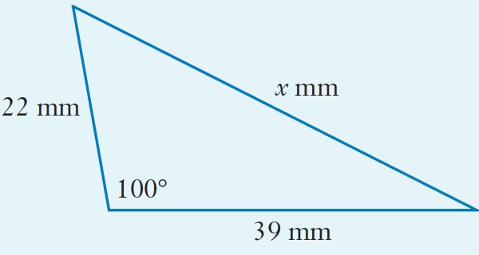
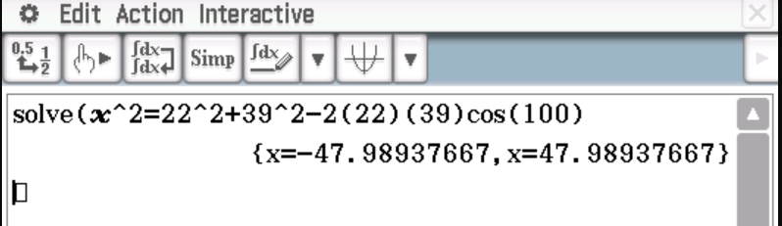
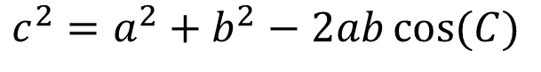
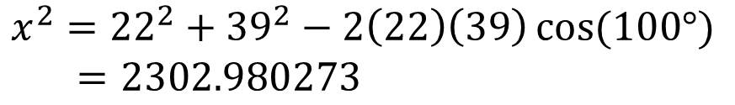
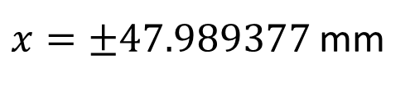

Skill Development
$$c^{2}=a^{2}+b^{2}−2ab\cos{(C)}$$
$$x^{2}={22}^{2}+{39}^{2}−2\left(22\right)\left(39\right)\cos{(100°)}$$
$=2302.980273$
$x=±47.989377$ mm
$x cannot be negative∴x=47.99$ mm (2d.p)

Slide 15






Guided Practice
Note:
For Cosine rule, there is no possible of a second solution because if the angle is obtuse, we will obtain a NEGATIVE value for its cosine.
$$c^{2}=a^{2}+b^{2}−2ab\cos{(C)}$$
$${8.3}^{2}={6.9}^{2}+{5.2}^{2}−2\left(6.9\right)\left(5.2\right)\cos{(x)}$$
$${8.3}^{2}+2\left(6.9\right)\left(5.2\right)\cos\left(x\right)={6.9}^{2}+{5.2}^{2}$$
$$2\left(6.9\right)\left(5.2\right)\cos\left(x\right)={6.9}^{2}+{5.2}^{2}−{8.3}^{2}$$
$$\cos\left(x\right)=\frac{{6.9}^{2}+{5.2}^{2}−{8.3}^{2} }{2(6.9)(5.2)}$$
$$x=85.40°$$

Slide 16









Guided Practice
The sketch below shows a system of three triangles with lengths and angles indicated. BAE is a straight line. Find the length of CD.
$$c^{2}=a^{2}+b^{2}−2ab\cos{(C)}$$
$${21}^{2}={33}^{2}+{48}^{2}−2(33)(48)\cos{(y)}$$
$${68}^{2}={41}^{2}+{37}^{2}−2(41)(37)\cos{(z)}$$
$$y=21.279966$$
$$z=121.250926$$
$$x=180−y−z$$
$$x=37.46910723$$
$${CD}^{2}={41}^{2}+{33}^{2}−2(41)(33)\cos{(x)}$$
$$CD=±24.95mm$$
$CD=24.95mm$ (CD cannot be negative)

Slide 17



Guided Practice
Using cosine rule:
$$x^{2}=6^{2}+4^{2}−2\left(6\right)\left(4\right)cos⁡(30)$$
$x=±3.23$
$x=3.23$ km (x cannot be negative)

Slide 18






Guided Practice
Using cosine rule:
$$BD^{2}=4^{2}+6^{2}−2\left(4\right)\left(6\right)cos⁡(92)$$
$$BD=7.32 cm$$
Using Sine rule to find angle BDC
$$\frac{\sin\left(BDC\right)}{5}=\frac{\sin\left(88\right)}{7.32}$$
$∠BDC=43.05°$ ($≠136.95° ∵sum of angles is 180°$)
$$∠DBC=180−88−43.05=48.95°$$
Using Sine rule to find length CD
$$\frac{CD}{\sin{(48.95)}}=\frac{7.32}{sin⁡(88)}$$
$CD=5.52$ cm

Slide 19


Sine or Cosine rule?
Summary
Sine Rule
2 sides, 1 angle or 2 angles, 1 side
Cosine Rule
3 sides or
2 sides, 1 angle

Slide 20



Proving Sine Rule (Optional)
In triangle ABD;
$\sin{A= \frac{h}{c}}$ ,
therefore $h=c\sin{A}$
B
c
In triangle CBD;
$\sin{C= \frac{h}{a}}$ ,
therefore $h=a\sin{C}$
a
h
Hence
$$c\sin{A} =a\sin{C}$$
Rearranging
$$\frac{a}{\sin{A}}=\frac{c}{\sin{C}}$$
A
C
b
D

Slide 21


Proving Cosine rule (Optional)
B
In triangle ABD; using Pythagoras’
$$c^{2}=h^{2}+{(b−x)}^{2}$$
$=h^{2}+b^{2}−2bx+x^{2}$ (1)
In triangle BDC; using Pythagoras’
$a^{2}= h^{2}+x^{2}$ (2)
Sub (2) into (1)
$c^{2}=a^{2}+b^{2}−2bx$ (3)
We also know that $\cos{c= \frac{x}{a}}$ , therefore $x=a\cos{C}$ and sub this into (3)
$$c^{2}=a^{2}+b^{2}−2ba\cos{C}$$
c
a
h
A
C
D
b
Let DC = x,
hence AD = b – x

Slide 22
Independent Practice
Complete Cambridge Ex 13B, 13C

